Slide 1


SW Architecture의 이해
명지대학교/OMG Korea
최성운
choisw@mju.ac.kr

Slide 2
Software-Intensive Enterprise Application Development

Slide 3

Business Mega Trend 2007
Business Environment
Information Technology Issues
Interoperability
  Inter-Department
  Inter-Enterprise
Business Ecosystem
  Distribution
  Collaboration
Faster Business Velocity
Real-Time Enterprise
  Immediate Detection
  Faster Response
Reusability
  Component/Framework
  Process Integration
Predictability/Adaptability
  Quantitative Management
  Agile Process

Slide 4
Standish CHAOS Report
Standish Group CHAOS Report (March 25, 2003)
  프로젝트 성공률: 34% (‘94년 16%)
  프로젝트 실패율: 15% (‘94년 31%)
  문제 있는 프로젝트: 51% (’94년과 동일)
    비용 초과 비율: 43% (’94년 18%)
    납기 지연 비율: 82% (’00 63%)
    요구 기능 제공비율: 52% (‘00년 67%)
  IT 실패 비용: $550억/$2550억
  (’94년 $1400억/$2500억)
- <number> -

Slide 5
프로젝트 10대 실패 요인
Top 10 Factors
Mean Score
1. Inadequate requirements specification
4.5
2. Changes in requirements
4.3
3. Shortage of systems engineers
4.2
4. Shortage of software managers
4.1
5. Shortage of qualified project managers
4.1
6. Shortage of software engineers
3.9
7. Fixed price contract
3.8
8. Inadequate communications of systems integration
3.8
9. Insufficient experience as a team
3.6
10. Shortage of application domain experts
3.6
5 : Very Serious, 3 : Serious, 1: Not Serious
CMU, SEI, 2003

Slide 6

Building Large, Complex Systems
Large-scale design decisions cannot be made by programmers.
  Have limited visibility and short-term perspectives
  Trained in technology solutions to specific problems.
Making broad design decisions that apply to the entire system – all of its elements
  Can coordinate teams and
  Can achieve QA’s

Slide 7
Functionality Is Not Enough₁
If the only criterion for software was to get the right answer, we would not need architectures - unstructured, monolithic systems would suffice.
But other things also matter, such as
  Required capability
  Low learning threshold
  Ease of use
  Predictable behavior
  Dependable service
  Timely response
  Timely throughput
  Protection from unintended intruders and viruses
  …….

Slide 8
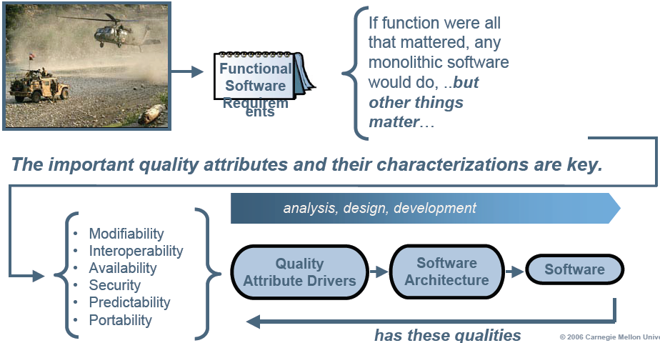
Functionality Is Not Enough₂

Slide 9














Software-Intensive
Enterprise Application Development
개발
영역
분석
아키텍처 설계
시스템
설계
시스템
구현
시험
유지
보수
사용자
목표 시스템
관리
?
일정
예산
품질
형상
조직
지원
도구
프로세스
플랫폼 & 프레임워크
표준

Slide 10
Information Technology Issues
- <number> -
Process Based
Optimized
Managed
Interoperability
Flexibility
Reusability
Measurability
Traceability
Model-Driven
Architecture-Centric
Standardization
Tool Support
Traceability
Consistency
Systematic Reuse
Framework
Component
지원
도구
프로세스
플랫폼 & 프레임워크
표준

Slide 11
Systematic Reuse: Frameworks & Components
- <number> -
Application Engineering
Application
Framework
Application
Architecture
Component
Customization
Component
Composition
Applications
Requirements
Asset
Repository
Classification/Distribution
Configuration Management
Retrieval/Explanation
Requirements
Frameworks
Components
Requirements
Framework Engineering
Component Engineering
Domain
Analysis
Framework
Qualification
Component
Qualification
Domain
Analysis
Framework
Design
Framework
Implementation
Component
Implementation
Component
Design

Slide 12
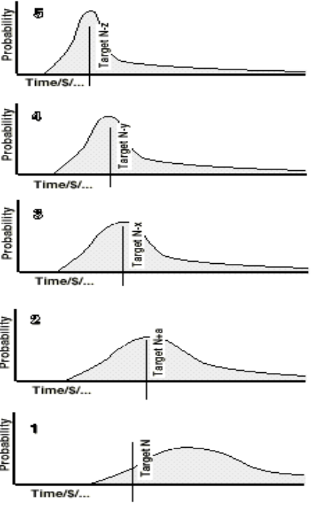
Process-Based: CMM/SPICE
프로세스가 효과적이기 위해서는 프로세스의 실제 결과를 예측할 수 있어야 함.(비용, 일정, 품질 등)
프로세스를 따르므로 해서 기대되는 결과를 예측하기 위해서는 프로세스가 명시적으로 정의되고, 관리되고, 예측되고, 통제될 수 있어야 함
단계
프로세스 특징
예상되는 성과
5
최적화
프로세스 개선을 제도화함
4
계량적
관리됨
제품과 프로세스를 정량적으로 통제함
현수준
3
정의됨
S/W 엔지니어링과 관리 프로세스를
조직적 차원에서 정의(표준화)하고 통합함
2
관리됨
프로젝트 관리는 되고 있으며,
성능이 반복적임
1
초기
프로세스가 비공식적이고 예측할 수
없음
Notes:
단계별 성숙도에 따라 그 능력의 특징들이 정의되어 있습니다.
1단계는 결과를 예측할 수 없는 단계이며, 사람에 의해 결과가 좌지우지되는 단계를 말합니다.
2단계는 비슷한 결과들이 예측되고 반복되어지는 경험 많은 조직입니다. 관리는 되고 있으나 이 것이 내재화되고 표준화된 프로세스에 의한 관리가 아닌 것입니다.
마찬가지고 사람의 경험이 노하우가 되어 관리는 되고 있으나 공유할 수 있는 경험과 지식이 아닌 것입니다. 현재의 신한이 이러한 단계의 모습을 보이고 있습니다.
이 단계에서는 능력있고 경험많은 관리자가 빠져나가면 다시 1단계의 수준으로 되돌아 갈 수 밖에 없는 조직입니다. 능력이 조직화되어 조직에 내재화되어 있어야 합니다.
3단계는 프로세스가 표준화되고 잘 정의되어 있으며, 잘 수행되고 있습니다. 그러나 이 프로세스가 관리되거나 통제되지 않은 단계입니다.
4단계는 프로세스가 관리되고 통제되는 단계입니다. 관리되고 통제되기 위해서는 측정되거나 평가되어 그 결과를 데이터로 관리하고 있어야 합니다.
프로세스 수행 결과에 대한 데이터를 수집하고 분석하여 결과를 피드백할 수 있는 단계입니다.
5단계는 지속적인 프로세스 개선에 의해 최적의 프로세스를 갖추고 있는 단계를 말합니다. 프로세스에 관련된 조직(인력), 제도, 인프라 등이 최적화되어 있는 상태입니다.
오른쪽 그림을 보면 약간의 차이점이 발견될 수가 있습니다.
1단계는 목표를 제대로 못 맞추는 모습이며, 2 단계는 비슷하게 맞추기는 하지만 시행착오가 많은 단계입니다.
3단계부터는 목표에 대한 정확도가 높으면서 점점 납기가 짧아지는 모습을 볼 수 있습니다. 그 만큼 생산성이 높아지는 것을
볼 수 있습니다.

Slide 13
Tool Support: CASE, IDE
© Myongji Univ., OOS Lab.
Focused on implementation
  Early stage CASE products concentrated on COBOL for mainframes and SQL for relational databases
  In 1990, the software world changed from mainframes to Unix and PCs, to C and VB, and to client-server architectures
Heterogeneous computing environment
  Paradigm/Technology
  Repository
  Notation
2002/1/10

Slide 14
Model-Driven & Architecture-Centric
- <number> -
Measurability/Predictability
Reusability
  Framework & Components
Traceability
Interoperability
Flexibility
Continuous Improvement
ACT
PLAN
CHECK
DO
Software Process Improvement

Slide 15
Software Architecture

Slide 16

S/W Architecture
The fundamental organization of a system, embodied in its components, their relationships to each other and the environment, and the principles governing its design and the evolution _{[ANSI/IEEE Std 1471 2000]}
The structure or structures of the system, which comprise software elements, the externally visible properties of those elements, and the relationships among them _{[Bass, et.al., 2003]}
{Components, Relationships, Principles}

Slide 17

Implications
Fundamental Organization / Structures
  Serving as, or being an essential part of an organization _{[webster’s]}
  A foundation or basis of an organization
To satisfy important user needs
  High quality software meets business goals and user needs
  It has the right features and the right quality attributes

Slide 18
Recommended Practice for Architectural Description of Software-Intensive Systems _{[IEEE 1471 ]}
Mission
fulfils 1..*
Environment
influences
System
has an
Architecture
inhabits
described by 1
has 1..*
Stakeholder
identifies
1..*
Architectural
Description
provides
Rationale
is important to
1..*
is addressed to
1..*
participates in
has
1..*
selects
1..*
organized by
1..*
identifies
1..*
Concern
Viewpoint
View
used to
over 1..*
conforms to
participates in 1..*
aggregates
1..*
has source
0..1
consists of 1..*
Library
Viewpoint
Model
establishes
methods for
1..*

Slide 19
Views & Viewpoints
View
  A representation of a whole system from the
  perspective of a set of concerns
  What you see/Specific
Viewpoint
  The perspective from which a view is taken
  How to construct and use a view/Generic
    The information that should appear in the view
    The modeling techniques for expressing and analyzing the information
    Rationale for these choices

Slide 20
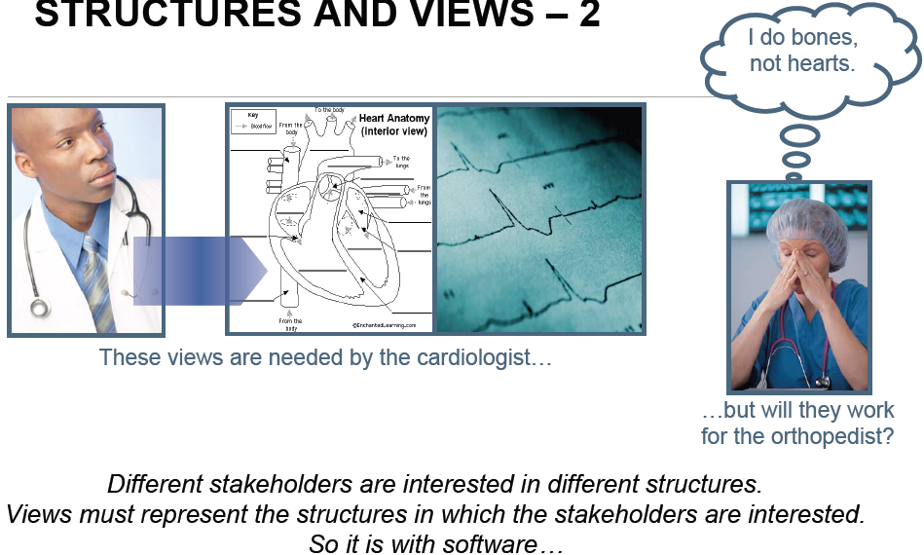
Multiple Views

Slide 21
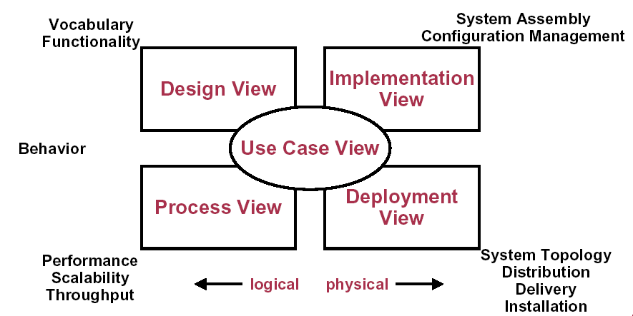
4+1 Views in Unified Process _{[Kruchten]}

Slide 22
Why Is S/W Architecture Important?
Represents earliest design decisions
  Hardest to change
  Most critical to get right
  Communication vehicle among stakeholders
First design artifact addressing
  Performance
  Modifiability
  Reliability
  security
Key to systematic reuse
  Transferable, reusable abstraction

Slide 23
Good Architecture Provides
Well-designed software architecture that
  Lays out the basic elements of construction
  Is known to satisfy important quality goals
Well-defined parts – components that
  Have specific roles and interfaces
  Have known properties
  Behave predictably in a given assembly
Well-defined production plan that prescribes
  The order and method of assembly
  Individual and team goals

Slide 24
Framework
Myongji Univ / OMG
A set of cooperating classes that make up a reusable design for a specific class of software _{[Gamma 1994]}
A set of components working together so they address a number of problems in one or more domains _{[Carey 2002]}
A generic package _{[D’Souza 1998]}
  A framework is applied by importing its package, and substituting problem-specific elements for the generic model elements as appropriate.
  A framework defines patterns in generic terms by using placeholders for elements. It can be applied to a family of related types to generate different models and designs.
Notes:
A tool which can be used for developing a broad range of different system _{[TOGAF 2001]}
Method for designing an information system in terms of a set of building blocks, and for showing how the building blocks fit together.
A set of tools/Common vocabulary/A list of recommended standards
Compliant products that can be used to implement the building blocks

Slide 25
Framework & Application
Myongji Univ / OMG
Framework _{[Atkinson 2002]}
  A reusable set of software artifacts whose core is embedded within all products developed by the enterprise
  Consolidation of common parts of the family within a reusable core
Application
  A concrete instance of the framework
Variability
Commonality
Variability

Slide 26
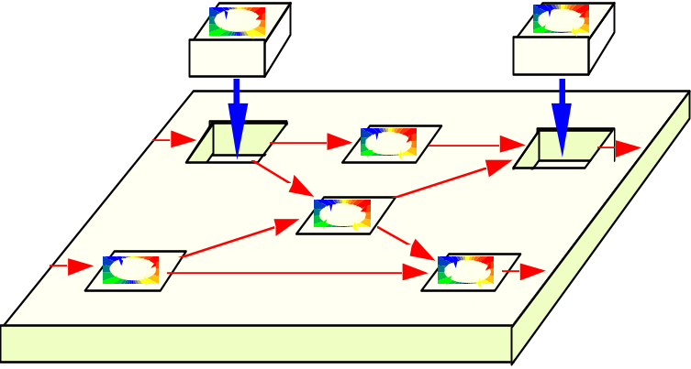
Framework Revisited
Process Tailoring Framework
The framework is adapted to the needs and constraints of the adopting organization
Framework
(ex. J2SE, .NET)
Instance
A framework such as the J2SE attempts to provide the universe of possible elements applicable to a vast range of projects and organizations.
A framework instance is a tailored subset of the framework, applied to a particular organizational or project context.
Notes:
Have a look at the Guidelines in the on-line process for more background on this topic.

Slide 27
Enterprise Architecture Frameworks
The Open Group Architecture Framework
John Zachman's Zachman Framework
Steven Spewak's Enterprise Architecture Planning
Treasury Enterprise Architecture Framework
Federal Enterprise Architecture Framework
DoD C4ISR Architecture Framework

Slide 28
Zachman Framework for Enterprise Architecture
abstractions
DATA
What
FUNCTION
How
NETWORK
Where
PEOPLE
Who
TIME
When
MOTIVATION
Why
perspectives
List of Things -
Important to the Business
List of Processes -
the Business Performs
List of Locations -
in which the Business Operates
List of Organizations -
Important to the Business
List of Events -
Significant to the Business
List of Business Goals and Strategies
SCOPE
Planner
contextual
Entity = Class of
Business Thing
Function = Class of
Business Process
Node = Major Business
Location
People = Class of People and
Major Organizations
Time = Major Business Event
Ends/Means=Major Business
Goal/Critical Success Factor
ENTERPRISE
MODEL
Owner
e.g., Semantic Model
e.g., Business Process Model
e.g., Logistics Network
e.g., Work Flow Model
e.g., Master Schedule
e.g., Business Plan
conceptual
Entity = Business Entity
Rel. = Business Relationship
Process = Business Process
I/O = Business Resources
Node = Business Location
Link = Business Linkage
People = Organization Unit
Work = Work Product
Time = Business Event
Cycle = Business Cycle
End = Business Objective
Means = Business Strategy
SYSTEM
MODEL
Designer
e.g., Logical Data Model
e.g., Application Architecture
e.g., Distributed System
Architecture
e.g., Human Interface
Architecture
e.g., Processing Structure
e.g., Business Rule Model
logical
Entity = Data Entity
Rel. = Data Relationship
Process.= Application Function
I/O = User Views
Node = IS Function
Link = Line Characteristics
People = Role
Work = Deliverable
Time = System Event
Cycle = Processing Cycle
End = Structural Assertion
Means =Action Assertion
TECHNOLOGY
CONSTRAINED
MODEL
Builder
e.g., Physical Data Model
e.g., System Design
e.g., Technical Architecture
e.g., Presentation Architecture
e.g., Control Structure
e.g., Rule Design
physical
Entity = Tables/Segments/etc.
Rel. = Key/Pointer/etc.
Process= Computer Function
I/O =Data Elements/Sets
Node = Hardware/System
Software
Link = Line Specifications
People = User
Work = Screen/Device Format
Time = Execute
Cycle = Component Cycle
End = Condition
Means = Action
DETAILED
REPRESEN-
TATIONS
Subcontractor
e.g. Data Definition
e.g. Program
e.g. Network Architecture
e.g. Security Architecture
e.g. Timing Definition
e.g. Rule Specification
out-of-context
Entity = Field
Rel. = Address
Process= Language Statement
I/O = Control Block
Node = Addresses
Link = Protocols
People = Identity
Work = Job
Time = Interrupt
Cycle = Machine Cycle
End = Sub-condition
Means = Step
FUNCTIONING
ENTERPRISE
DATA
Implementation
FUNCTION
Implementation
NETWORK
Implementation
ORGANIZATION
Implementation
SCHEDULE
Implementation
STRATEGY
Implementation
John A. Zachman, Zachman International

Slide 29
Federal Enterprise Architecture Framework
Data
Architecture
Application
Architecture
Technology
Architecture
Planner
Perspective
List of Business Objects | List of Business Processes | List of Business Locations
Semantic Model | Business Process Model | Business Logistics System
Logical Data Model | Application Architecture | System Geographic Deployment Architecture
Physical Data Model | Systems Design | Technology Architecture
Data Dictionary | Programs | Network Architecture
Owner
Perspective
Designer
Perspective
Builder
Perspective
Subcontractor
Perspective
FEAF (Federal Enterprise Architecture Framework)

Slide 30
Platform
A horizontal surface _{[Webster’s]}
Platform
Platform
Platform

Slide 31
Architecture-Centric Software System Development

Slide 32
Architecture-Centric
S/W System Development₁
System Engineer
Define
a Mission
Identify a
Framework
Design the
System
Stakeholder
<<include>>
<<include>>
<<include>>
Architect
Implement
a System
<<include>>
Document
Requirements
Develop an
Architecture
<<include>>
Developer

Slide 33
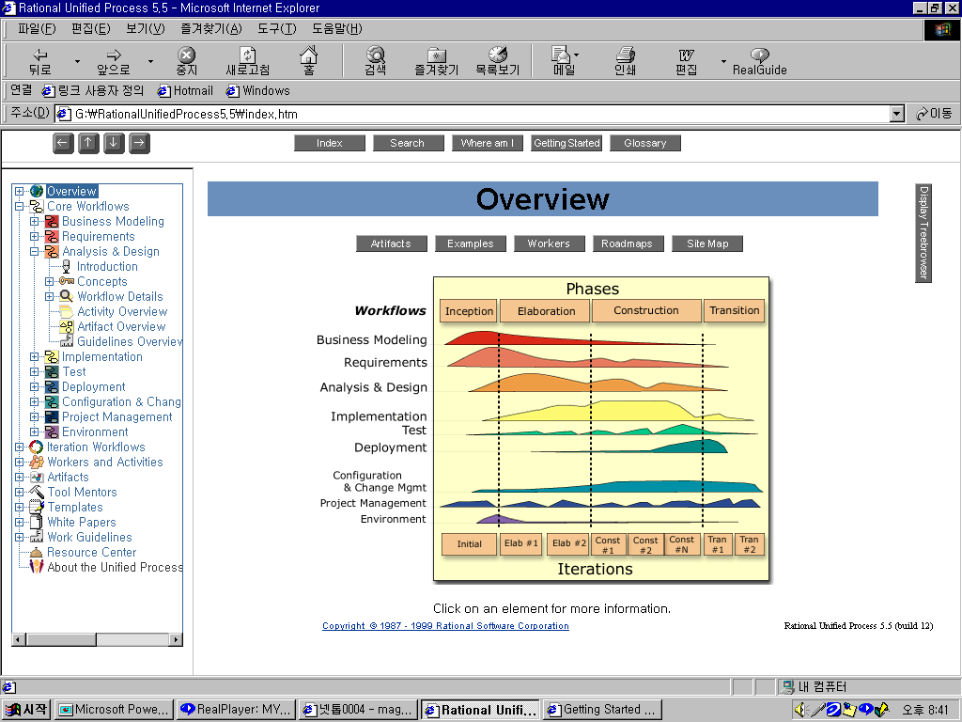
Unified Process
Workflows
Business Modeling
Requirements
Analysis & Design
Implementation
Test
Deployment
Configuration &
Change Mgmt
Project Management
Environment
Milestones
Conceptual Prototype
Architectural
Baseline
Release
Delivery 1

Slide 34
Architecture-Centric
S/W System Development₂
Requirements
Requirements Engineering
Drive
Architecture
Architecture Definition
Architecture Evaluation
Feeds
Specifies
Components
Component Development
COTS Utilization
Mining Existing Assets
Developing an acquisition strategy
Constitute
System
Software System Integration
Testing

Slide 35
Requirements Engineering
The hardest single part of building a software system is deciding precisely what to build. … [Brooks 87]
Steps
  Requirements elicitation
  Requirements analysis
  Requirements specification
  Requirements verification
  Requirements management

Slide 36
Architecture Definition
Attribute-Driven Design (ADD) Steps
  Choose the architectural drivers from the set of concrete quality scenarios and functional requirements
  Choose an architectural pattern that satisfies the architectural drivers.
  Instantiate modules and allocate functionality from the use cases and represent using multiple views
  Define interfaces of the child modules
  Verify and refine use cases and quality scenarios and make them constraints for the child modules

Slide 37
Architecture Evaluation
Results
  Is this architecture suitable for the system for which it was designed?
  Which of two or more competing architectures is the most suitable one for the system at hand?
  Suitability
    The system should meet its quality goals
    The system can be built based on current resources
Architecture Evaluation Methods
  Architecture Tradeoff Analysis Method (ATAM)
  Software Architecture Analysis Method (SAAM)
  Active Reviews for Intermediate Designs (ARID)

Slide 38
COTS Utilization
COTS (Commercial Off-The shelf) product utilization steps
  Analyze the architecture in detail
    Flexibility & Variability point
  Understand the requirements of the organization
    Constraints or Standards
  Study market place in detail
  Develop requirements in a flexible manner
    Articulate broad categories of needs and possible trade-offs
  Develop an approach for the evaluation of products and technologies
    price, vendor stability, … / performance, security, …
  Select viable products and technologies
  Buy the products
  Integrate products into the architecture
    Do not underestimate the task of integration
  Test the product and the configuration of products
  Manage the system on an ongoing basis
COTS Component/Architecture/Framework

Slide 39
Mining Existing Assets
Focus on large-grained assets
Determine how the candidate asset can fit into the architecture
Consider the requirements for quality attributes
Weigh the cost of developing the asset from scratch versus the cost of the required changes that will be made in the mined assets
Mining undocumented software assets requires tool support

Slide 40
Developing an Acquisition Strategy
Acquisition
  The process of obtaining products and services through contracting
Acquisition strategy
  Establishing the number and types of contracts needed to satisfy the acquisition requirements
  Choosing the contract types, funding alternatives, contract options, and source selection procedures
  Considering how the continuity of contractual products and services can best be sustained over the projected lives of participating projects

Slide 41
System Integration
In a waterfall model
  A discrete step toward the end of the development life cycle
In an incremental Model
  An ongoing activity

Slide 42
Test
Analysis/Design Model Validation
Unit Testing
Subsystem Integration Testing
System Integration Testing
Regression Testing
Conformance Testing
Acceptance Testing
Deployment Testing
Reliability Testing

Slide 43
Quality Model Framework
ISO 9126

Slide 44
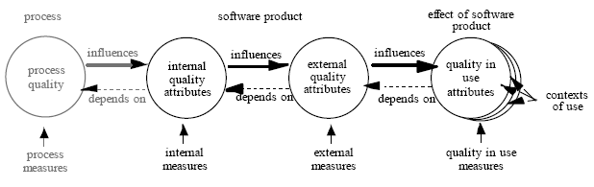
Quality in the Lifecycle₁
Quality
  Character with respect to grade of excellence or fineness
Quality in the lifecycle
  Appropriate internal attributes of the software are a pre-requisite for achieving the required external behavior, and appropriate external behavior is a pre-requisite for achieving quality in use.
  The requirements for software product quality will generally include assessment criteria for internal quality, external quality and quality in use, to meet the needs of developers, maintainers, acquirers and end users.

Slide 45
Quality in the Lifecycle₂
Quality in Use
  User quality needs include requirements for quality in use in specific contexts of use. These identified needs can be used when specifying external and internal quality using software product quality characteristics and sub-characteristics.
Internal/External Quality
  Software product quality can be evaluated by measuring internal attributes (typically static measures of intermediate products), or by measuring external attributes (typically by measuring the behavior of the code when executed), or by measuring quality in use attributes. The objective is for the product to have the required effect in a particular context of use.
Process Quality
  Process quality (the quality of any of the lifecycle processes defined in ISO/IEC 12207) contributes to improving product quality, and product quality contributes to improving quality in use. Therefore, assessing and improving a process is a means to improve product quality, and evaluating and improving product quality is one means of improving quality in use. Similarly, evaluating quality in use can provide feedback to improve a product, and evaluating a product can provide feedback to improve a process.

Slide 46
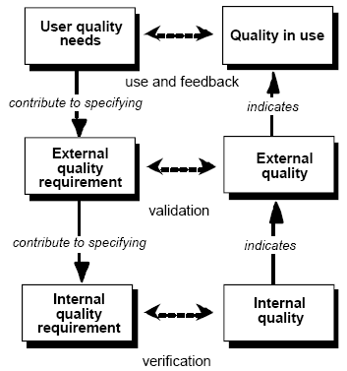
Quality in the Lifecycle₃
User quality needs can be specified as quality requirements by quality in use metrics, by external metrics, and sometimes by internal metrics.
Achieving a product which satisfies the user’s needs normally requires an iterative approach to software development with continual feedback from a user perspective.

Slide 47
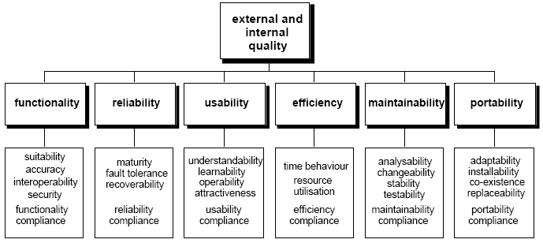
Product’s View of Quality

Slide 48
Functionality
The capability of the software product to provide functions which meet stated and implied needs when the software is used under specified conditions. This characteristic is concerned with what the software does to fulfill needs, whereas the other characteristics are mainly concerned with when and how it fulfils needs.
Suitability
  The capability of the software product to provide an appropriate set of functions for specified tasks and user objectives.
Accuracy
  The capability of the software product to provide the right or agreed results or effects with the needed degree of precision.
Interoperability
  The capability of the software product to interact with one or more specified systems.
  NOTE: Interoperability is used in place of compatibility in order to avoid possible ambiguity with replaceability
Security
  The capability of the software product to protect information and data so that unauthorized persons or systems cannot read or modify them and unauthorized persons or systems are not denied access to them.
  NOTE: Safety is defined as a characteristic of quality in use, as it does not relate to software alone, but to a whole system.
Functionality compliance
  The capability of the software product to adhere to standards, conventions or regulations in laws and similar prescriptions relating to functionality.

Slide 49
Reliability
The capability of the software product to maintain a specified level of performance when used under specified conditions. Wear or ageing does not occur in software. Limitations in reliability are due to faults in requirements, design, and implementation. Failures due to these faults depend on the way the software product is used and the program options selected rather than on elapsed time.
Maturity
  The capability of the software product to avoid failure as a result of faults in the software.
Fault tolerance
  The capability of the software product to maintain a specified level of performance in cases of software faults or of infringement of its specified interface.
  NOTE The specified level of performance may include fail safe capability.
Recoverability
  The capability of the software product to re-establish a specified level of performance and recover the data directly affected in the case of a failure. Following a failure, a software product will sometimes be down for a certain period of time, the length of which is assessed by its recoverability.
  NOTE : Availability is the capability of the software product to be in a state to perform a required function at a given point in time, under stated conditions of use. Externally, availability can be assessed by the proportion of total time during which the software product is in an up state. Availability is therefore a combination of maturity (which governs the frequency of failure), fault tolerance and recoverability (which governs the length of down time following each failure). For this reason it has not been included as a separate sub-characteristic.
Reliability compliance
  The capability of the software product to adhere to standards, conventions or regulations relating to reliability.

Slide 50
Usability
The capability of the software product to be understood, learned, used and attractive to the user, when used under specified conditions. Users may include operators, end users and indirect users who are under the influence of or dependent on the use of the software. Usability should address all of the different user environments that the software may affect, which may include preparation for usage and evaluation of results.
Understandability
  The capability of the software product to enable the user to understand whether the software is suitable, and how it can be used for particular tasks and conditions of use. This will depend on the documentation and initial impressions given by the software.
Learnability
  The capability of the software product to enable the user to learn its application. NOTE The internal attributes correspond to suitability for learning as defined in ISO 9241-10.
Operability
  The capability of the software product to enable the user to operate and control it. Aspects of suitability, changeability, adaptability and installability may affect operability. Operability corresponds to controllability, error tolerance and conformity with user expectations as defined in ISO 9241-10. For a system which is operated by a user, the combination of functionality, reliability, usability and efficiency can be measured externally by quality in use.
Attractiveness
  The capability of the software product to be attractive to the user. This refers to attributes of the software intended to make the software more attractive to the user, such as the use of color and the nature of the graphical design.
Usability compliance
  The capability of the software product to adhere to standards, conventions, style guides or regulations relating to usability.

Slide 51
Efficiency
The capability of the software product to provide appropriate performance, relative to the amount of resources used, under stated conditions. Resources may include other software products, the software and hardware configuration of the system, and materials (e.g. print paper, diskettes). For a system which is operated by a user, the combination of functionality, reliability, usability and efficiency can be measured externally by quality in use.
Time Behavior
  The capability of the software product to provide appropriate response and processing times and throughput rates when performing its function, under stated conditions.
Resource Utilization
  The capability of the software product to use appropriate amounts and types of resources when the software performs its function under stated conditions. Human resources are included as part of productivity
Efficiency compliance
  The capability of the software product to adhere to standards or conventions relating to efficiency.

Slide 52
Maintainability
The capability of the software product to be modified. Modifications may include corrections, improvements or adaptation of the software to changes in environment, and in requirements and functional specifications.
Analyzability
  The capability of the software product to be diagnosed for deficiencies or causes of failures in the software, or for the parts to be modified to be identified.
Changeability
  The capability of the software product to enable a specified modification to be implemented. Implementation includes coding, designing and documenting changes. If the software is to be modified by the end user, changeability may affect operability.
Stability
  The capability of the software product to avoid unexpected effects from modifications of the software.
Testability
  The capability of the software product to enable modified software to be validated.
Maintainability compliance
  The capability of the software product to adhere to standards or conventions relating to maintainability.

Slide 53
Portability
The capability of the software product to be transferred from one environment to another. The environment may include organisational, hardware or software environment.
Adaptability
  The capability of the software product to be adapted for different specified environments without applying actions or means other than those provided for this purpose for the software considered. Adaptability includes the scalability of internal capacity (e.g. screen fields, tables, transaction volumes, report formats, etc.). If the software is to be adapted by the end user, adaptability corresponds to suitability for individualization as defined in ISO 9241-10, and may affect operability.
Installability
  The capability of the software product to be installed in a specified environment. If the software is to be installed by an end user, installability can affect the resulting suitability and operability.
Co-existence
  The capability of the software product to co-exist with other independent software in a common environment sharing common resources.
Replaceability
  The capability of the software product to be used in place of another specified software product for the same purpose in the same environment. For example, the replaceability of a new version of a software product is important to the user when upgrading. Replaceability is used in place of compatibility in order to avoid possible ambiguity with interoperability. Replaceability may include attributes of both installability and adaptability. The concept has been introduced as a subcharacteristic of its own because of its importance.
Portability compliance
  The capability of the software product to adhere to standards or conventions relating to portability.

Slide 54
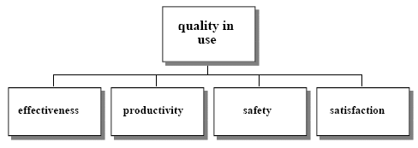
User’s View of quality
Quality in use is the user’s view of quality. Achieving quality in use is dependent on achieving the necessary external quality, which in turn is dependent on achieving the necessary internal quality.
The capability of the software product to enable specified users to achieve specified goals with effectiveness, productivity, safety and satisfaction in specified contexts of use. Quality in use is the user's view of the quality of an environment containing software, and is measured from the results of using the software in the environment, rather than properties of the software itself.

Slide 55
Quality in use
Effectiveness
  The capability of the software product to enable users to achieve specified goals with accuracy and completeness in a specified context of use.
Productivity
  The capability of the software product to enable users to expend appropriate amounts of resources in relation to the effectiveness achieved in a specified context of use. Relevant resources can include time to complete the task, the user’s effort, materials or the financial cost of usage.
Safety
  The capability of the software product to achieve acceptable levels of risk of harm to people, business, software, property or the environment in a specified context of use. Risks are usually a result of deficiencies in the functionality (including security), reliability, usability or maintainability.
Satisfaction
  The capability of the software product to satisfy users in a specified context of use. Satisfaction is the user’s response to interaction with the product, and includes attitudes towards use of the product.

Slide 56
Quality Framework with Multiple Views & Phases₁
구현
종료
 | Resource | Process | Product | Customer
Business Manager
Project Manager
Engineer
분석
설계
대상
비용가격
산정
착수
관점
사업참여 준비
Delivery
Sales
시점

Slide 57
Quality Framework with Multiple Views & Phases₂
구성요소(축) |  | 정의
시점 (Phases) | 영업(Sales)
 | 실행(Delivery)
대상 (Abstractions) | 자원(Resource)
 | 절차(Process)
 | 제품(Product)
 | 고객(Customer)
관점 (Perspectives) | 경영자 (Business Manager)
 | 프로젝트관리자 (Project Manager)
 | 엔지니어 (Engineer)

Slide 58
What do architects do?

Slide 59
What Do Architects Do?
To understand how to help architects do what they do, we need to understand what they do
  What are their duties?
  What skills and knowledge made them “capable of performing their allotted or required function?”
Affinity Diagrams by SEI
  Originally developed by Jiro Kawakita, an anthropologist, to discover meaningful groups of ideas from a raw list. Kawakita’s idea is to examine the list and let groupings emerge naturally, using the right side of the brain, rather than following a preordained categorization.

Slide 60
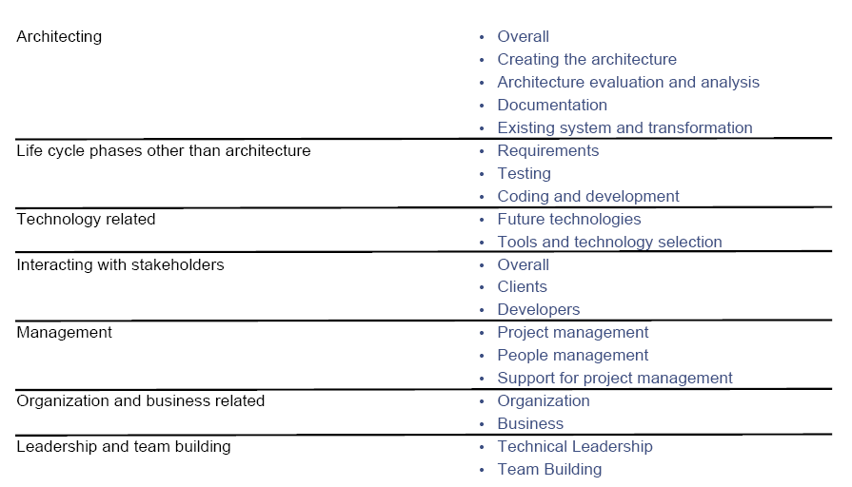
Architectural Duty Clusters

Slide 61
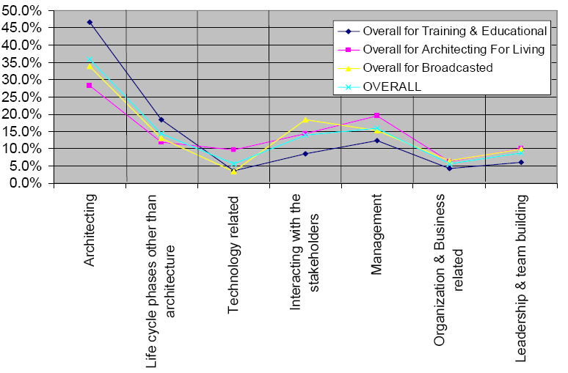
Architecture Duties
Notes:
1. None of the subcategories seems to be considered of paramount
importance by any of the sources groups. Everyone agrees: Architects
do a lot of different things!
2. Project management, requirements, and architecture evaluation and
analysis are the most often mentioned duties overall.
3. The overall curve almost overlaps with the curve corresponding to the
broadcast sources.
4. The training and education sources produce a noticeably different profile
than the ‘architecting for a living’ sources. See especially architecture
evaluation and architecting.
5. There seems to be a consensus about the “Overall” sub-category of
architecting, as well as the categories of organization and business
related duties, and leadership and team building.
6. Treatment of stakeholders varies noticeably. “Architecting for a living”
sources barely mention interacting with clients. The broadcast sources
mention interacting with stakeholders almost three times as much as the
“architecting for a living” sources.

Slide 62
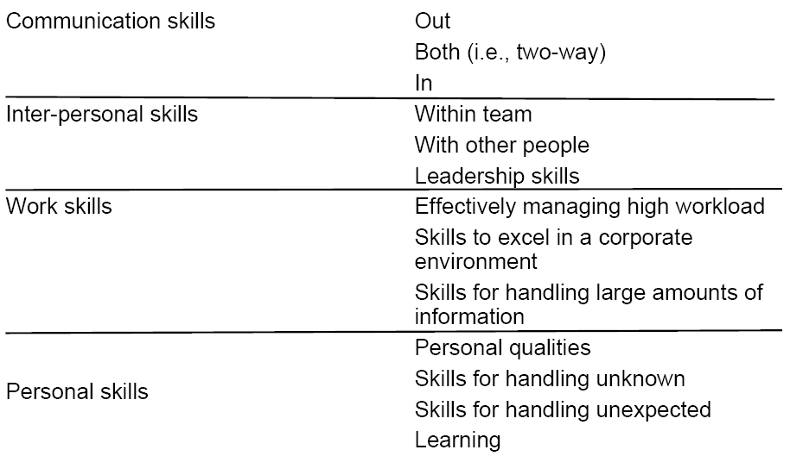
Architectural Skill Clusters

Slide 63
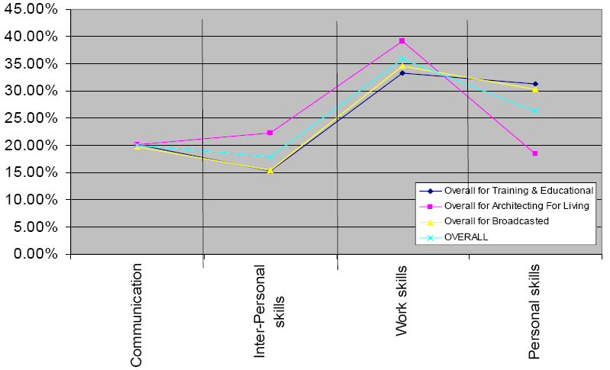
Architecture Skills
Notes:
1. All the curves agree on communication. “Communication – in” is barely
mentioned.
2. 2. “Architecting for a living” sources mention personal skills the least when
compared with other skills or with other sources. At the same time, they place
the most emphasis on work skills.
3. The overall curve follows the broadcast curve very closely. However, training
and education sources and “architecting for a living” sources are poles apart.
Gap between teachers and practitioners?
4. Overall, leadership skills and skills for handling the unknown are the two most
often cited.
5. “Architecting for a living” sources give maximum weight to leadership skills, and
minimum weight to skills of handling the unknown. In contrast, the training and
education sources completely differ and assign maximum weight to skills for
handling the unknown and minimum weight to leadership skills, when compared
with other sources.
6. Skills for handling the unknown and skills for handling the unexpected are two
different but related skill sets. But training and education sources assign the
former a score of about 18% while the latter less than 1%.
7. 7. All the sources almost converge for the following skills: skills for handling
unexpected, effectively managing high workload, inter-personal skills, and
communication skills.

Slide 64
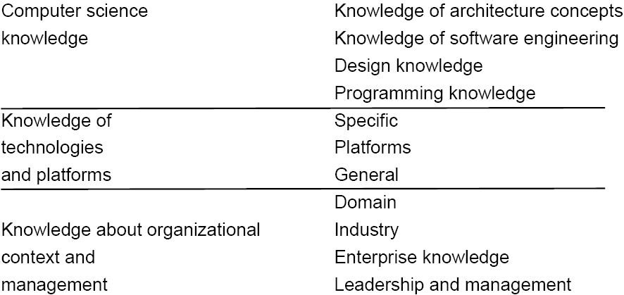
Architectural Knowledge Clusters

Slide 65
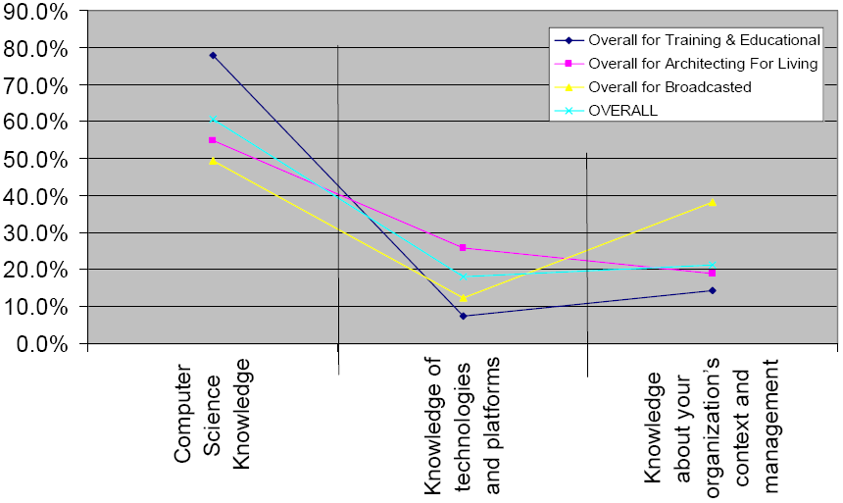
Architecture Knowledge
Notes:
1. All the sources consider computer science knowledge to be the most worth
mentioning. Training and education sources, as expected, weigh in the heaviest at
80%, while overall it is 60%. The major contributor to this category is knowledge of
architecture concepts. It seems this is what architects learn in universities and public
courses; other knowledge is generally picked up elsewhere.
2. Training and education sources and “architecting for a living” sources differ by 4x
when it comes to knowledge of architecture concepts.
3. “Architecting for a living” sources consider programming knowledge to be the most
important knowledge, five times as important when compared with other sources.
4. Sources agree on knowledge of software engineering, industry knowledge, and
general knowledge of technologies and platforms.
5. Both training and education sources and “architecting for a living” sources give
industry knowledge only around 1% score.
6. Leadership and management is poorly represented by all the sources as knowledge
area, whereas it turned out to be one of the most important skills. This seems to
validate the idea that leadership and management is more of a skill, not a knowledge
area.

Slide 66
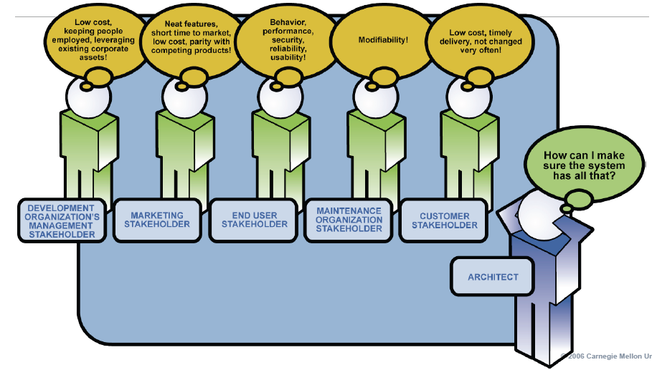
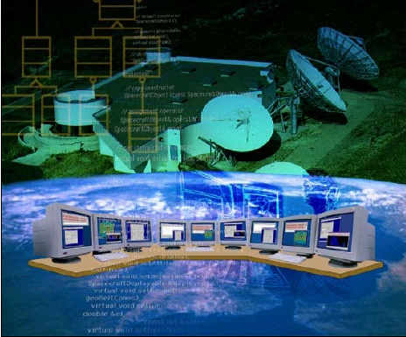
Software Architect & Architecture
Architect
  Engineer
  Manager
  Negotiator
Architecture
  The bridge between business and product goals and a software-intensive system
  Quality attribute requirements drive software architecture design
  Software architecture drives software development through the life cycle

Slide 67
References
Software Architecture in Practice, Len Bass, et al., Addison-Wesley, 2003
Evaluating Software Architecture, Paul Clements, et al., Addison-Wesley, 2002
Documenting Software Architecture, Paul Clements, et al., Addison-Wesley, 2003
The Open Group Architectural Framework, Version 7, TOGAF, 2001
Component-based Product Line Engineering with UML, Colin Atkinson, et al., Addison-Wesley, 2002
Software Product Lines, Paul Clements, et al., Addison-Wesley, 2002
Framework Process Patterns, James Carey, et al., Addison-Wesley, 2002
Objects, Components and Frameworks with UML, Desmond F. D’Souza, et al., Addison-Wesley, 1998
Development of Federal Enterprise Architecture Framework using the IBM Rational Unified Process and the Unified Modeling Language, Allen Sayles, Technical paper, IBM, 2003
Let’s Teach Architecting High Quality Software, Linda Northrop, CSEET 2006
Improving Software Architecture Competence, Paul Clements, 2007

Slide 68
Appendix:
Four Layer Metadata Architecture

Slide 69
Model-Driven
A way to specify and build systems
  language, vendor and middleware neutral
  supports full lifecycle : analysis, design, implementation, deployment, maintenance, evolution & integration with later systems
  builds in Interoperability and Portability
© Myongji Univ., OOS Lab.
Notes:
2-2 MDA Guide V1.0 1st May 2003
2.2 The Basic Concepts
Let’s look at the concepts that are at the core of MDA. Later chapters present each
concept in greater detail.
2.2.1 System
We present the MDA concepts in terms of some existing or planned system. That
system may include anything: a program, a single computer system, some combination
of parts of different systems, a federation of systems, each under separate control,
people, an enterprise, a federation of enterprises…
Much of the discussion focuses on software within the system.
2.2.2 Model
A model of a system is a description or specification of that system and its
environment for some certain purpose. A model is often presented as a combination
of drawings and text. The text may be in a modeling language or in a natural language.
2.2.3 Model-Driven
MDA is an approach to system development, which increases the power of models in
that work. It is model-driven because it provides a means for using models to direct the
course of understanding, design, construction, deployment, operation, maintenance and
modification.
2
2.2.4 Architecture
The architecture of a system is a specification of the parts and connectors of the
system and the rules for the interactions of the parts using the connectors. [5]
The Model-Driven Architecture prescribes certain kinds of models to be used, how
those models may be prepared and the relationships of the different kinds of models.
2.2.5 Viewpoint
A viewpoint on a system is a technique for abstraction using a selected set of
architectural concepts and structuring rules, in order to focus on particular concerns
within that system. Here ‘abstraction’ is used to mean the process of suppressing
selected detail to establish a simplified model.
The concepts and rules may be considered to form a viewpoint language.
Examples:
The Reference Model of Open Distributed Processing (ODP) provides five
viewpoints for specifying a distributed system. [1].
Another classification specifies three (very similar to the SPARC database model
viewpoints [2]): a conceptual viewpoint, describing the place of a system in the
situation in which that system will be (or is already) placed, a specification
(logical) viewpoint, specifying what that system must know and do, and an
implementation (physical) viewpoint, specifying in detail the construction of that
system. [3]
The Model-Driven Architecture specifies three viewpoints on a system, a computation
independent viewpoint, a platform independent viewpoint and a platform specific
viewpoint.
2.2.6 View
A viewpoint model or view of a system is a representation of that system from the
perspective of a chosen viewpoint. [4].
2.2.7 Platform
A platform in general is a set of subsystems/technologies that provide a coherent set of
functionality through interfaces and specified usage patterns that any subsystem that
depends on the platform can use without concern for the details of how the
functionality provided by the platform is implemented.

Slide 70
Model
© Myongji Univ., OOS Lab.
A formal/Informal specification of the function, structure and/or behavior of a system.
A specification is said to be formal when it is based on some well defined language that has well defined meaning associated with each of its constructs.
  Informal
    A diagram with boxes and lines and arrows that does not have behind it a definition of the meaning of a box and the meaning of a line and of an arrow
  Formal
    Source code that it can be executed by a machine.
A UML-based specification expressed visually or via an XML document.
2002/1/10
Notes:
2-2 MDA Guide V1.0 1st May 2003
2.2 The Basic Concepts
Let’s look at the concepts that are at the core of MDA. Later chapters present each
concept in greater detail.
2.2.1 System
We present the MDA concepts in terms of some existing or planned system. That
system may include anything: a program, a single computer system, some combination
of parts of different systems, a federation of systems, each under separate control,
people, an enterprise, a federation of enterprises…
Much of the discussion focuses on software within the system.
2.2.2 Model
A model of a system is a description or specification of that system and its
environment for some certain purpose. A model is often presented as a combination
of drawings and text. The text may be in a modeling language or in a natural language.
2.2.3 Model-Driven
MDA is an approach to system development, which increases the power of models in
that work. It is model-driven because it provides a means for using models to direct the
course of understanding, design, construction, deployment, operation, maintenance and
modification.
2
2.2.4 Architecture
The architecture of a system is a specification of the parts and connectors of the
system and the rules for the interactions of the parts using the connectors. [5]
The Model-Driven Architecture prescribes certain kinds of models to be used, how
those models may be prepared and the relationships of the different kinds of models.
2.2.5 Viewpoint
A viewpoint on a system is a technique for abstraction using a selected set of
architectural concepts and structuring rules, in order to focus on particular concerns
within that system. Here ‘abstraction’ is used to mean the process of suppressing
selected detail to establish a simplified model.
The concepts and rules may be considered to form a viewpoint language.
Examples:
The Reference Model of Open Distributed Processing (ODP) provides five
viewpoints for specifying a distributed system. [1].
Another classification specifies three (very similar to the SPARC database model
viewpoints [2]): a conceptual viewpoint, describing the place of a system in the
situation in which that system will be (or is already) placed, a specification
(logical) viewpoint, specifying what that system must know and do, and an
implementation (physical) viewpoint, specifying in detail the construction of that
system. [3]
The Model-Driven Architecture specifies three viewpoints on a system, a computation
independent viewpoint, a platform independent viewpoint and a platform specific
viewpoint.
2.2.6 View
A viewpoint model or view of a system is a representation of that system from the
perspective of a chosen viewpoint. [4].
2.2.7 Platform
A platform in general is a set of subsystems/technologies that provide a coherent set of
functionality through interfaces and specified usage patterns that any subsystem that
depends on the platform can use without concern for the details of how the
functionality provided by the platform is implemented.

Slide 71
Metamodel
© Myongji Univ., OOS Lab.
A model of models
A language(Generator) to describe(generate) models
  The MOF meta-metamodel is the language used to define the UML metamodel,
  the UML metamodel is the language used to define UML models, and
  a UML model is a language that defines aspects of a computer system.
Model 1
Metamodel
Model N
2002/1/10
Notes:
ab/2001-02-04 Model Driven Architecture - A Technical Perspective 3
21st February 2001 Draft
3.1 What is a Model
Some people define a model as a visual representation of a system. However, many
people refer to a set of IDL interfaces as a “CORBA object model.” Furthermore, a
specification expressed in terms of UML can be rendered into an XML document using
the OMG’s XMI DTD for UML, which certainly is not a visual artifact. Thus, we
conclude that this definition is too limiting.
We offer the following definition: A model is a formal specification of the function,
structure and/or behavior of a system.
A specification is said to be formal when it is based on some well defined language
that has well defined meaning associated with each of its constructs. A specification
that is not formal in this sense, is not a model. Thus a diagram with boxes and lines
and arrows that does not have behind it a definition of the meaning of a box and the
meaning of a line and of an arrow is not a model—it is just an informal diagram.
Note that under this definition, source code is a model that has the salient characteristic
that it can be executed by a machine. A set of IDL interfaces is a model that can be
used with any CORBA implementation and that specifies the signature of operations
and attributes of which the interfaces are composed. A UML-based specification is a
model whose properties can be expressed visually or via an XML document.
We could have taken the stance that a model is not necessarily formal, so that we could
talk about formal and informal models, which in a way seems to be quite natural
discourse. However we then would end up with a very weak definition of model such
as “a representation of a system.” We feel that the definition that encompasses
formality is more useful.
For a nice discussion about modeling the enterprise in particular see Section 3 of
“Model-Driven Architecture - Opportunities and Callenges” by Desmond DSouza,
OMG document number ab/2001-02-03. In general this document presents a very nice
perspective on MDA.
3.2 Abstractions and Viewpoints
ISO’s Open Distributed Processing (ODP) Part II defines abstraction as the
suppression of irrelevant detail2. We view this as an appropriate definition. Thus, all
models are abstractions and term like “abstract model” can be very confusing. We must
be careful about the terminology we use to categorize different kinds of models.
It is useful to identify models in terms of the abstraction criteria that were used to
determine what is included in the model. A model that is based on a specific
abstraction criterion is often referred to as a model from that viewpoint, or in short as a
view of the system.
Another common use of the word abstraction is in the phrase higher level of
abstraction, which is used to characterize a model in which more of the details of the
system is elided as compared to a lower level of abstraction.
Furthermore in common usage, the notion of viewpoints and levels of abstraction are
used together such that a larger amount of detail from a viewpoint may be elided to
obtain a model from that viewpoint or a view, at a higher level of abstraction, while
little or no detail may be elided to obtain a model or view, at a low level of abstraction.
ISO’s ODP defines five standard viewpoints that are convenient to use to describe
systems. Many projects have used other sets of viewpoints to specify systems.

Slide 72
Framework for Metamodeling
© Myongji Univ., OOS Lab.
Four meta-layers
  Information layer
    Data that is to be described
  Model Layer
    Metadata that describes data in the information layer
    Metadata is informally aggregated as models
  Metamodel Layer
    Descriptions that define the structure and semantics of metadata
    Meta-metadata is informally aggregated as metamodels
    A metamodel is an “abstract language” for describing different kinds of data; i.e., a language without a concrete syntax or notation
  Meta-metamodel Layer
    Descriptions of the structure and semantics of meta-metadata.
    A meta-metamodel is an “abstract language” for describing different kinds of metadata
2002/1/10

Slide 73
Advantages of
Four Layer Metadata Architecture
© Myongji Univ., OOS Lab.
It can support any kind of model and modeling paradigm that is imaginable
It can allow different kinds of metadata to be related
It can allow metamodels and new kinds of metadata to be added incrementally,
It can support interchange of arbitrary metadata(models) and meta-metadata(metamodels) between parties that use the same meta-metamodel
2002/1/10

Slide 74
Four-Layer Metamodel Architecture
Process Tailoring Framework
Metamodeling
  The use of models to define other models
  The metamodel defines possible structures and the meaning to elements in a model; the meta-model is by itself another model
Hard-wired Meta-meta-model
M3 layer
meta-metamodel
MetaClass(“Record”,
[MetaAttr(“name”,String),
MetaAttr(“fileds”,List<“Field”>)] )
MetaClass(“Field”,…)
M2 layer
metamodels
Record(“StockQuote”,
[Field(“company”,String),
Field(“price”,FixedPoint)])
M1 layer
models
StockQuote(“Sunbeam Harvesters”,98.77)
StockQuote(“Ace Taxi Cab Ltd”,12.32)
…
M0 layer
information

Slide 75
User Objects/M0
Process Tailoring Framework
cM1:
CourseModule
meta-
metamodel
Olsen:
Student
DAT2160:
Course
cM2:
CourseModule
metamodel
model
compBaseDev:
CourseModule
user objects
(user data)
SCP:
StudentCourseProfile
:reached
A UML model instantiated, illustrated with an
object diagram( objects/ data)

Slide 76
Model/M1
Process Tailoring Framework
meta-
metamodel
Course
CourseModule
name : String
description : String
*
name : String
description : String
1..*
metamodel
1
1
*
StudentCourseProfile
model
*
reached
finished : boolean
user objects
(user data)
*
1
Student
A metamodel instantiated, a language to describe an
information domain, Illustrated with a class diagram

Slide 77
Metamodel/M2
Process Tailoring Framework
meta-
metamodel
Classifier
metamodel
Interface
Node
model
Class
isActive:Boolean
user objects
(user data)
Component
A meta-metamodel instantiated. The definition of
UML, a language to describe a model.

Slide 78
Meta-Metamodel/M3
Process Tailoring Framework
meta-
metamodel
MetaClass
metamodel
model
user objects
(user data)
MetaOperation
MetaAttribute
A language to describe metamodels. The level of
abstraction is higher than for a metamodel and it is
also typically more compact.

Slide 79
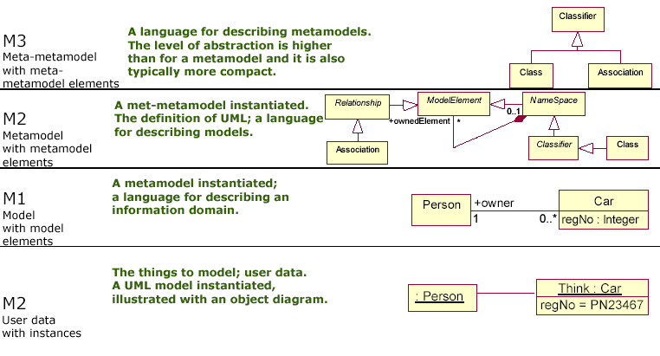
Four-Layer Metamodel Architecture Revisited
Process Tailoring Framework

